Slide 1
NFDUMP TOOLSET TESTING FOR IPFIX FLOW COLLECTION

Slide 2
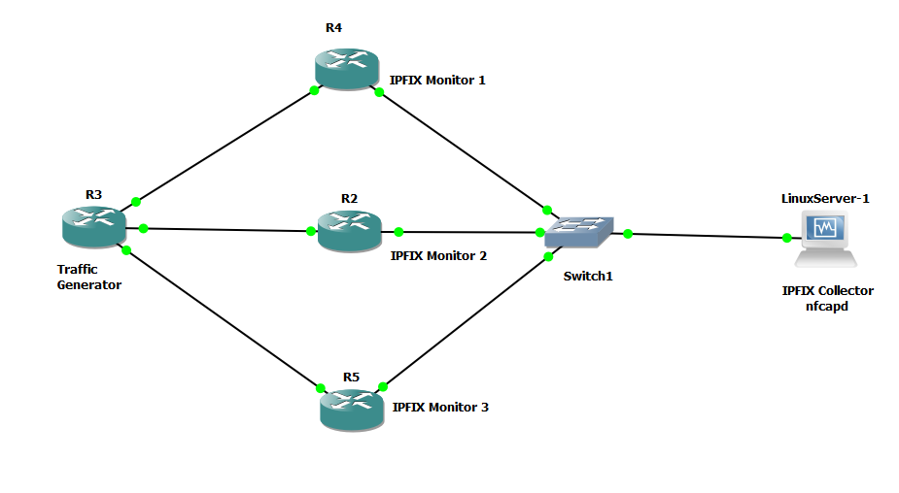
GNS3 Topology used for IPFIX Collector testing

Slide 3
Description of the topology
The Linux server and the routers R2,R4 and R5 belong to the same LAN
OSPF routing protocol is configured on the routers. The linux server has a default route to R2
The Traffic generating router R3 generates a continuous rotational source ping from each of the interfaces connected to it. The destination is the linux server. The generation of the ping is automated by using a python script running in the linux server
The ingress and egress interface is monitored for IP traffic on the three routers R2,R4 and R5, on the interfaces connected to the switch

Slide 4
Testing of IPFIX Collector
If a particular flow is inactive for 20 sec the flow expires and it is exported to a flow collector and for active flow ,flow is exported after 1 minute to the flow collector
Nfdump toolset is used to collect flows.Here it is in the Linux server
nfcapd belonging to the Nfdump toolset collects the exported flows and stores it in a file in a binary file.
nfcapd files are rotated for every n minutes. At the end of nth minute, the flows collected during those n minutes can be viewed using nfdump CLI command

Slide 5
Testing of IPFIX Collector
The nfdump command to read the nfcapd file is fired using a python script. The output containing the flows is processed and then the flow information is dumped in a mysql database
The testing has been done and the flows collected by using nfcapd is getting dumped into mysql database

